Slide 1
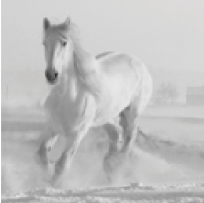
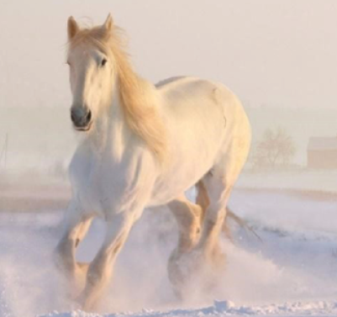
Convolutional Neural Network - Intuition
Introduction:
Image can be converted into matrix of pixel values
These pixel values ranges from 0 to 255
Dimension of this matrix will be of
[ Image width x Image height x number of channels]
A grayscale image has one channel
Size [3 x 3 x 1] >> Only one 2D matrix of shape (3 x 3)
coloured image have three channels (RGB)
Size [3 x 3 x 3] >> Totally three matrix and each of 2D matrix of shape (3 x 3)
Each refers channel Red, Green Blue respectively
0 | 2 | 3
9 | 2 | 3
2 | 2 | 1
0 | 2 | 3
9 | 2 | 3
2 | 2 | 1
4 | 2 | 3
9 | 7 | 3
2 | 2 | 10
6 | 2 | 5
9 | 13 | 3
2 | 2 | 5

Slide 2
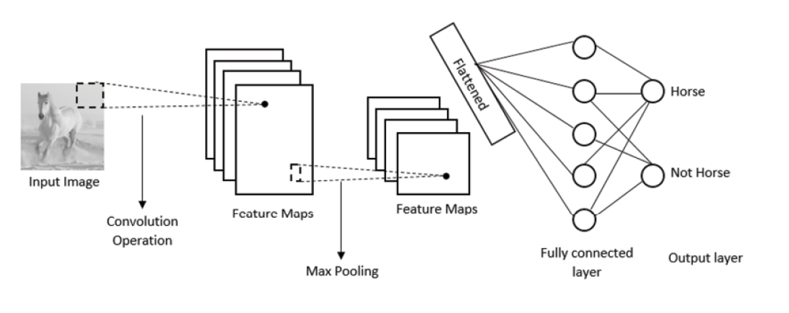
Convolutional Neural Network Architecture:
- CNN is extracting features from the image to understand patterns about it.
Patterns are normally : Edges, Shapes, Textures, Curves, Objects, Colours

Slide 3
Convolutional Operation:
Input image is represented by a matrix of pixel values and there is a filter or kernel matrix which will do convolution
This filter matrix slide over the input matrix by stride i.e pixel, perform element-wise multiplication, sum the results and produce a single number.
For example consider input matrix of 3 X 3 and filter 2 x 2
0 | 2 | 3
9 | 2 | 3
2 | 2 | 1
0 | 1
1 | 0
0 | 2 | 3
9 | 2 | 3
2 | 2 | 1
0 | 2 | 3
9 | 2 | 3
2 | 2 | 1
0 | 2 | 3
9 | 2 | 3
2 | 2 | 1
0 | 2 | 3
9 | 2 | 3
2 | 2 | 1
0 | 2
9 | 0
0 | 3
2 | 0
0 | 2
2 | 0
0 | 3
2 | 0
11 | 5
4 | 5
Feature Map Or Activation Map

Slide 4
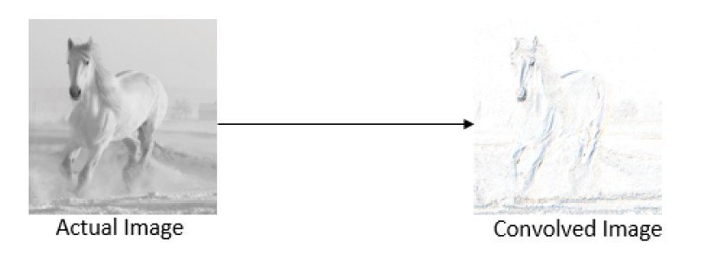
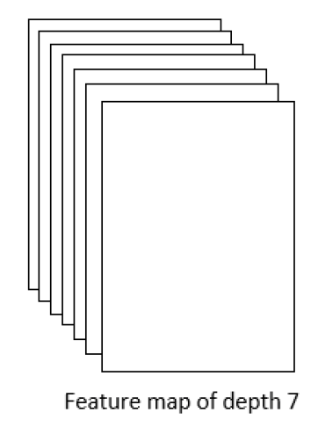
Feature map representing the extracted features.
Here filter has detected the edges from the actual image
Can use multiple filters to extract different features from the image
Depth of the feature map will be the number of filters
These filter matrix can be initialized randomly and the optimal values of filter matrix will be learned by back propagation.
It is expected of us to specify size of the filter and number of filters during building of NN
For example if convolution operation is defined with seven filter, there will be seven feature map

Slide 5
Importance of Strides:
When stride is set to small number, can encode a more detailed representation of the image.
When stride is set to high value , can encode with less time to compute but not a detailed encoding.
If stride is set to 2, than slide over the input matrix with the filter matrix by two pixels as below,
0 | 2 | 3 | 4
9 | 2 | 3 | 5
2 | 2 | 1 | 7
3 | 5 | 6 | 9
0 | 2 | 3 | 4
9 | 2 | 3 | 5
2 | 2 | 1 | 7
3 | 5 | 6 | 9
Stride of 2

Slide 6
Importance of Padding:
Due to convolving process, the input size is getting smaller and smaller at every time, whenever filter is provided
While convolving, the information is getting lost at the edge of the image.
To Avoid this , zero padding pixels are introduced around the edges of image and output image size is not decreased
0 | 0 | 0 | 0 | 0 | 0
0 | 0 | 2 | 3 | 4 | 0
0 | 9 | 2 | 3 | 5 | 0
0 | 2 | 2 | 1 | 7 | 0
0 | 3 | 5 | 6 | 9 | 0
0 | 0 | 0 | 0 | 0 | 0
0 | 2 | 3 | 4
9 | 2 | 3 | 5
2 | 2 | 1 | 7
3 | 5 | 6 | 9
0 | 2 | 3
9 | 2 | 3
2 | 2 | 1
Input matrix : Before padding 4 x 4
After padding 6 x 6
Filter matrix 3 x 3 Output matrix 4 x 4
If padding mode is ‘Valid’, then Convolution layer is not going to pad at all
If padding mode is ‘Same’ then output size is the same as the input size after padding is applied all edges of input matrix

Slide 7
Importance of Pooling layers:
Pooling Operation is also called as ‘Down Sampling’ Or ‘Sub Sampling’ operation.
The pooling layers reduces spatial dimensions by keeping only the important features
Max Pooling Operation:
While slide over the filter on input matrix , simply take the maximum value from the filter window
Average Pooling Operation:
While slide over the filter on input matrix, take average value of the input matrix within the filter window
Sum Pooling Operation:
While slide over the filter on input matrix, sum all the values of the input matrix within the filter window
0 | 2 | 3 | 4
9 | 7 | 11 | 1
21 | 17 | 19 | 13
31 | 6 | 8 | 15
Sum Pooling
18 | 19
65 | 55
Average Pooling
4.5 | 4.75
16.25 | 13.75
Max Pooling
9 | 11
31 | 19
2 x 2 Filter with stride 2

Slide 8
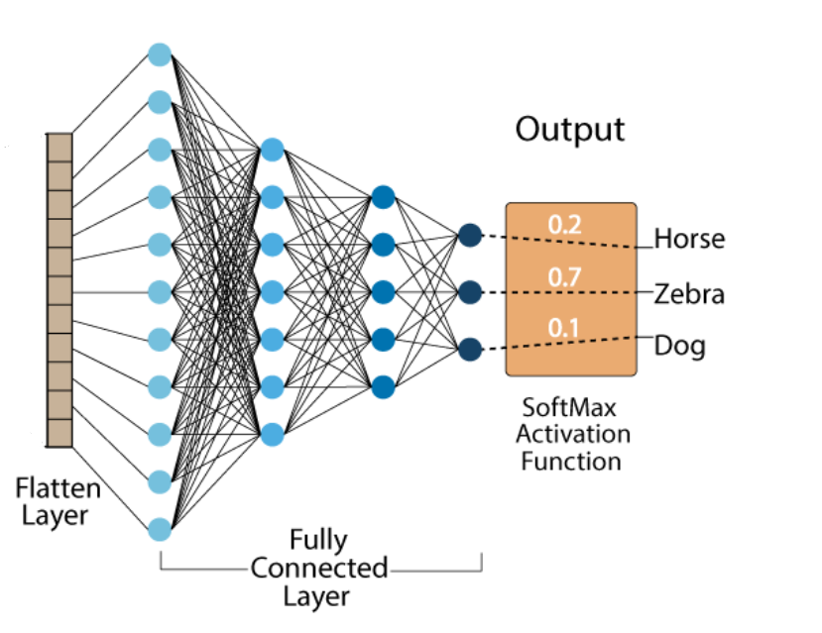
Fully Connected layers
Given any image, convolutional layers extract features from the image and produce a feature map.
Flattening this feature map , produces vector and feed it to the feed forward network
Feed forward network takes the flattened features and applies an activation function and returns the output
This output stating whether the image contains which category of features or not .

